Slide 1
Cloudflare Magic Transit
Extend the power of Cloudflare to your on-prem networks

Slide 2
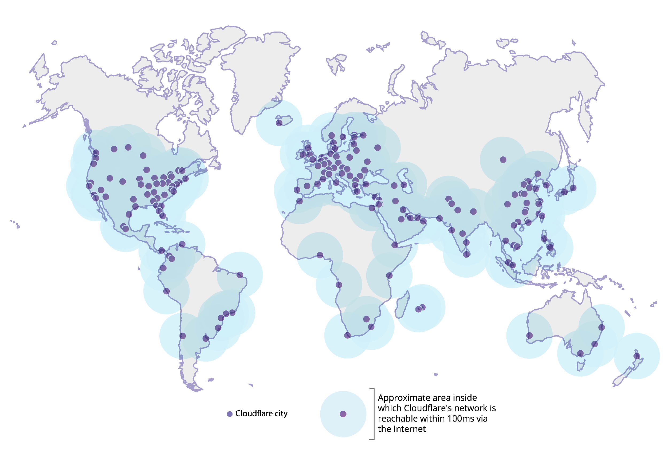
Global anycast network
26M+
Internet properties
200+
Cities in more than 90 countries
35 Tbps
Network capacity
DDoS mitigation capacity
99%
Of the Internet-connected developed world population is located within 100 milliseconds of our network
Confidential. Copyright © Cloudflare, Inc.
Note: Data as of August, 2019.
Notes:
We’ve built a massive global anycast network over the last 9 years. Our global physical presence and the diversity of product and services we offer is unmatched.

Slide 3
Extending Cloudflare to networks
REVERSE PROXY
DDoS mitigation
IP firewall
L4
load balancing
TLS &
protocols
WAF
Content caching
Layer 3 — IP
Layer 4 — TCP
Layer 7 — HTTP
CUSTOMER ORIGIN NETWORK
CLOUDFLARE DATA CENTER
Notes:
When we started 9 years back, we focused on building services for the application layer — content caching, WAF, load balancing, etc.
But all these services we offer are dependent on our network — our data centers with physical servers needed to be protected from DDoS attacks themselves. Our options were to either buy existing DDoS mitigation boxes available in the market, or use existing cloud “scrubbing” providers. Both these solutions are not built with performance in mind, and frankly, not built to withstand volumetric and muti-vector sophisticated attacks.
So we built a DDoS detection and mitigation pipeline on commodity hardware to protect our own networks.
We are making this product we have been using for ourselves available to our customers.

Slide 4
Cloudflare’s battle-tested network stack, in front of customers’ data center
DDoS protection 35 Tbps network capacity Near-instant TTM
CUSTOMER DATA CENTER
Network firewall Granular Allow/Deny rules for IP ranges
35 Tbps DDoS mitigation capacity
LAYER 3 - IP
(MAGIC TRANSIT)
CLOUDFLARE DATA CENTER
Notes:
With Cloudflare Magic Transit, you can leverage our entire network to defend against the largest, most sophisticated attacks. Our battle-tested network is now available in front of your data centers to protect your network infrastructure from DDoS attacks.
This is not a new product. We’ve been using it for over 9 years. What’s new is that we’re now productizing it and making it available to you for your networks.

Slide 5
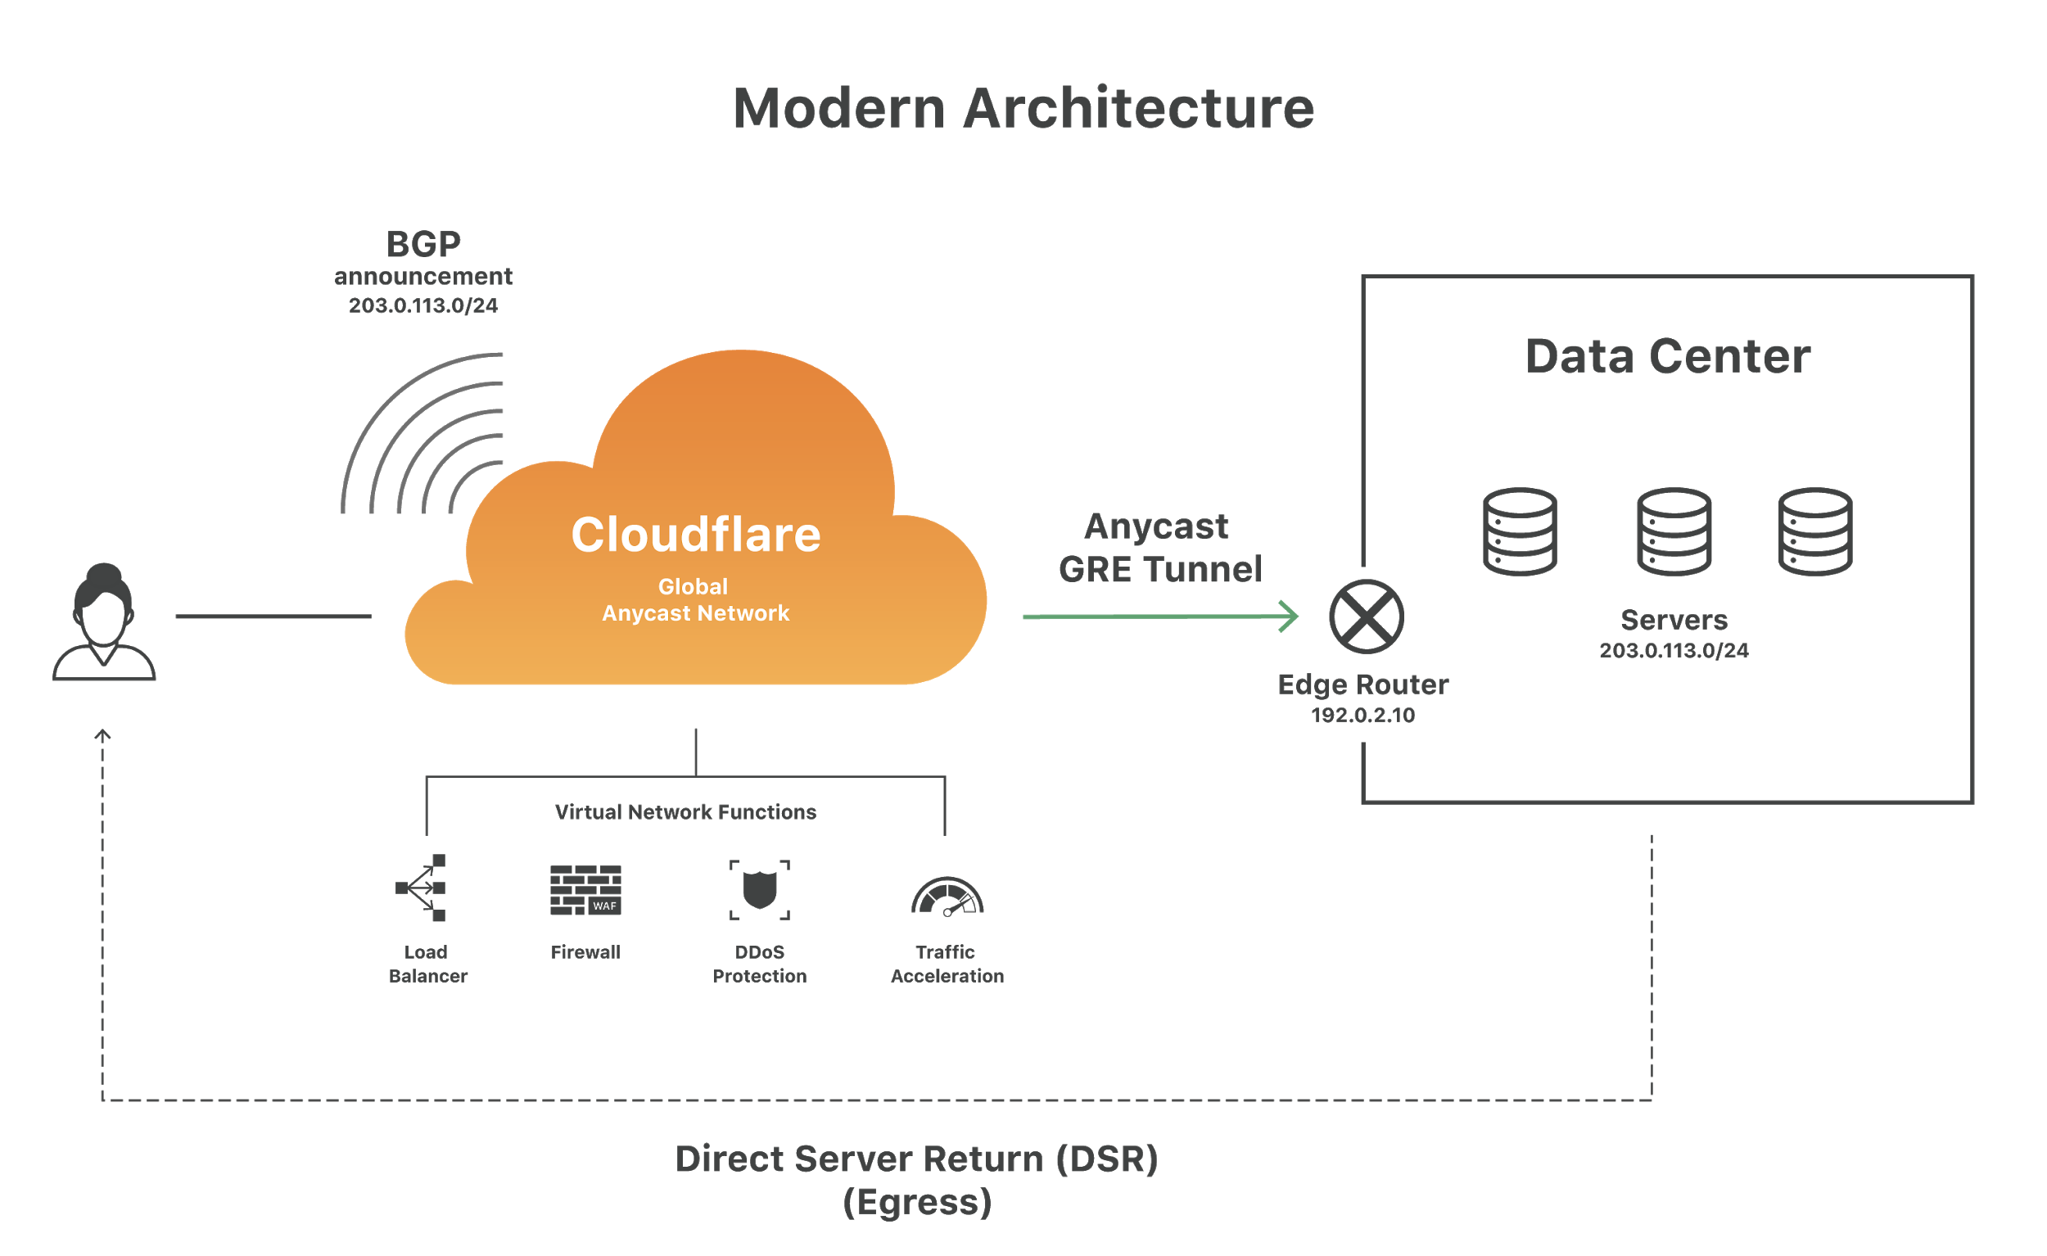
How it works
Connect:
Using BGP route announcements customer network traffic is ingested by Cloudflare
Protect and Process:
All traffic inspected for attacks automatically and immediately
Accelerate:
Clean traffic is routed back to the customer network over Cloudflare. Anycast GRE tunnels deliver traffic to the customer network
Notes:
OK, so how does it work?
We use BGP to announce routes to the customer’s network. Note that this is fundamentally a different product than anything Cloudflare has ever offered. This is not a simple DNS redirect. It’s a more involved process where we tell the Internet that we are the customer’s network and ingest all traffic destined to their networks using BGP. We can announce any customer network that is larger than a /24 prefix.
Once ingested by a Cloudflare data center closest to the source, the traffic is inspected for any threats. Of course, any L7 traffic that would benefit from content caching or WAF inspection is “upgraded” to our L7 pipeline without incurring additional network hops.
All clean network traffic is then encapsulated using GRE and tunneled over from the Cloudflare data center to the customer network. GRE tunnels are initiated from Cloudflare’s anycast endpoints to the customer’s network. Anycast GRE tunnels (where one of the tunnel endpoints is our Anycast IP address) ensure they are highly available and resilient to network failures that would bring traditional GRE tunnels down.
Finally, any egress traffic from the customer’s network is sent directly to the requestor/ client using Direct Server Return.

Slide 6
The Cloudflare difference
Feature
CLOUDFLARE
THE REST
Use BGP and BYOIPs
Return traffic over GRE
Global network w/ 35 Tbps DDoS mitigation capacity
Instant threat detection and TTM < 10 sec
Integrated performance benefits
Native integration of L3/4/7 products
Built-in L3 firewall
Built in-house on commodity hardware
Notes:
What’s our differentiated value?
As with other providers, we support BGP and Bring Your Own IPs, and return customer traffic back to their network encapsulating it using GRE
The biggest advantage we have is our network - we have a DDoS mitigation capacity of over 30 Tbps. Our mitigation capacity for network infrastructure protection is higher than that of Radware, Neustar, Imperva, and Akamai Prolexic — combined.
Unlike other vendors that have a limited subset of “scrubbing centers” where DDoS detection and mitigation occurs, Cloudflare announces your routes from each of our data centers in 190+ cities across the globe to provide near-instant threat detection and < 10 sec inline mitigation.
As with anything Cloudflare, we ensure your performance is not impaired. We are working on traffic acceleration benefits that will be integrated into this product
Not only do all our products natively integrate with each other, but you can also manage them from a single dashboard
You get built-in network firewall that you can deploy as another function on the fly
And all our products are built in-house on our own servers- which means we’re not dependant on third party vendors. We can deploy patches, do firmware upgrades leveraging the learnings from our vast network very quickly. We are a company that’s known for our innovation, and building software on commodity hardware helps us innovate fast, and even keep our costs down and pass those savings on to our customers.

Slide 7
Benefits
Get rid of network perimeter hardware DDoS protection, network firewall, traffic acceleration, and more delivered as a service
Get security + performance for your networks Cloudflare has a physical presence in over 200 cities across 90+ countries. Magic Transit delivers DDoS protection with integrated performance benefits
Drive down your TCO Pay exactly for only what you use. Get operational agility with VNFs delivered and billed as a service
Notes:
Now on to the benefits of Magic Transit:
One — it helps customers get rid of boxes. Many bigger companies are at some stage of their path towards digital transformation, and as cliche as it sounds, Magic transit does help companies further adopt the cloud. Network functions delivered as a service are easy to configure and manage.
Two — it gives customers access to Cloudflare’s expansive network, that not only protects but also accelerates anything connected to it. Security with integrated performance. Cloudflare is one of the most interconnected networks in the world. We work with carriers, Internet exchanges and peering partners around the world to ensure that every bit placed on our network will reach its destination quickly and reliably.
Third — costs. More and more companies we talk to are looking for ways to reduce their Capex. Magic Transit helps you dramatically reduce your Capex and delivers operational agility with VNFs delivered and billed as a service. This is a huge plus.

Slide 8
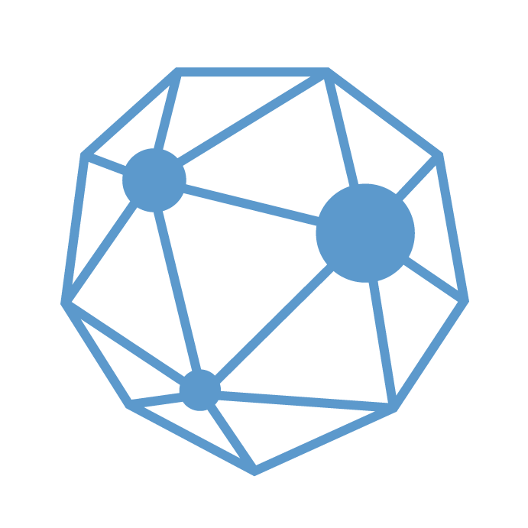
Current Attack Coverage
UDP Fragment | SNMPv2 | XMAS | flood Payload
DNS | ACK* | GRE | zzzz Payload
NTP | RPC | RIP | SPSS
CLDAP | RESET | QOTD | QUIC
Memcached | ICMP | IPMI | Dahua
OpenVPN | FIN | WS-DISCOVERY | VxWorks
UDP | NetBIOS | Teeworlds | XDisplayManager
CharGEN | MSSQL | VSE | BitTorrent
SYN | TFTP | LOIC | Ubiquity
SSDP | MDNS | Teamspeak | CoAP
Notes:
I would add that our automatic mitigations kick in only over a certain threshold (i.e. 100Kpps for SYN, UDP and similar floods) and so if the customer wants to rate-limit traffic before it reaches those rates, we can apply a rate-limiting rule which can impact legitimate traffic as well. The rate-limits are enforced per-metal (but not configurable per metail).

Slide 9
Summary - Key Features
DDoS mitigation capacity > 30 Tbps
Mitigate most attacks in < 10 seconds
Sub-second threat detection
BGP routing and GRE encapsulation
Native integration with L7 services (CDN, WAF, Bot Management, etc.)
Support for all IP services (TCP, UDP, IPSec, VoIP, custom protocols)
Notes:
Here’s a summary with all the key features of the product on one slide. We’re here happy to answer any questions you might have!

Slide 10
THANK YOU
Confidential. Copyright © Cloudflare, Inc.

