Slide 1
Cloudflare for Teams
Notes:
This is a customer-facing deck.

Slide 2
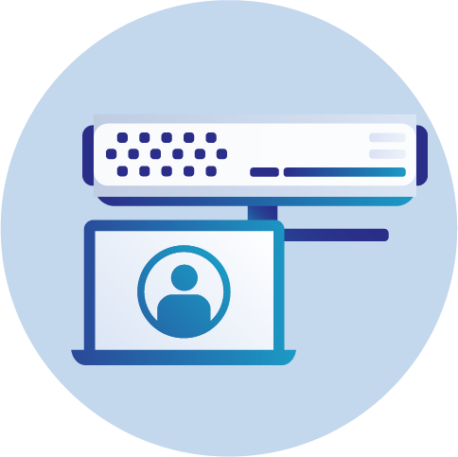
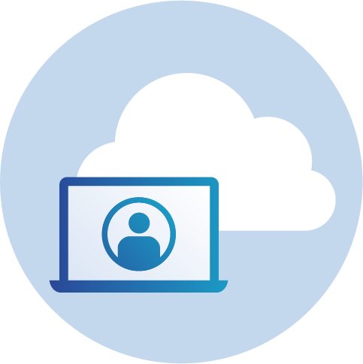
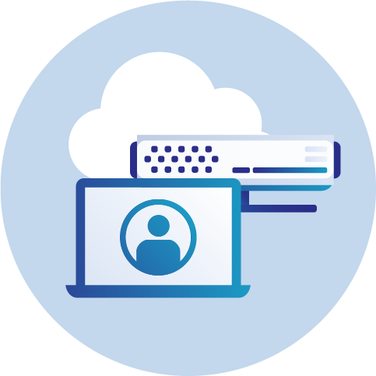
Team security did not scale with the Internet
Rapid change has left organizations with three problems they have to solve:
Secure team member access to internally managed applications
Secure team members on the public Internet
Secure the data that lives in both environments

Slide 3
Cloudflare for Teams
Protects enterprises, their devices, and their data by securing every connection without compromising user performance.

Slide 4
The Teams platform builds on advantages unique to Cloudflare
Industry-leading network and scale
Security intelligence from unique data sources
Faster connections that have been tested at scale
Data centers within 100 ms of 99% of Internet users
35 Tbps of capacity
Network presence in 200+ cities and 90 countries
Close to hubs and branch offices
Threat data gathered from securing more than 25M web properties
Cloudflare currently blocks 50B cyber threats per day
Intel from 11M HTTP requests per day on average
1.1.1.1 is the world’s fastest DNS resolver
Warp, the basis of our forward proxy, has 200k reviews and 4.5 rating
Argo Smart routing accelerates request on the Internet by 30%

Slide 5
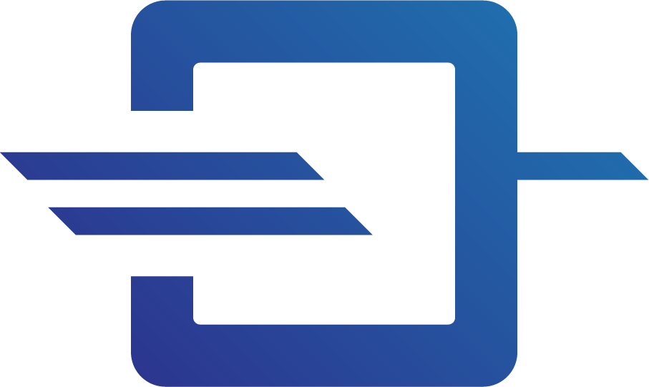
Cloudflare for Teams
Access
Gateway
Zero Trust security for any internal app. Built on top of Cloudflare’s global network.
A secure web gateway that’s faster and less cumbersome to manage and use.

Slide 6
Cloudflare Access

Slide 7
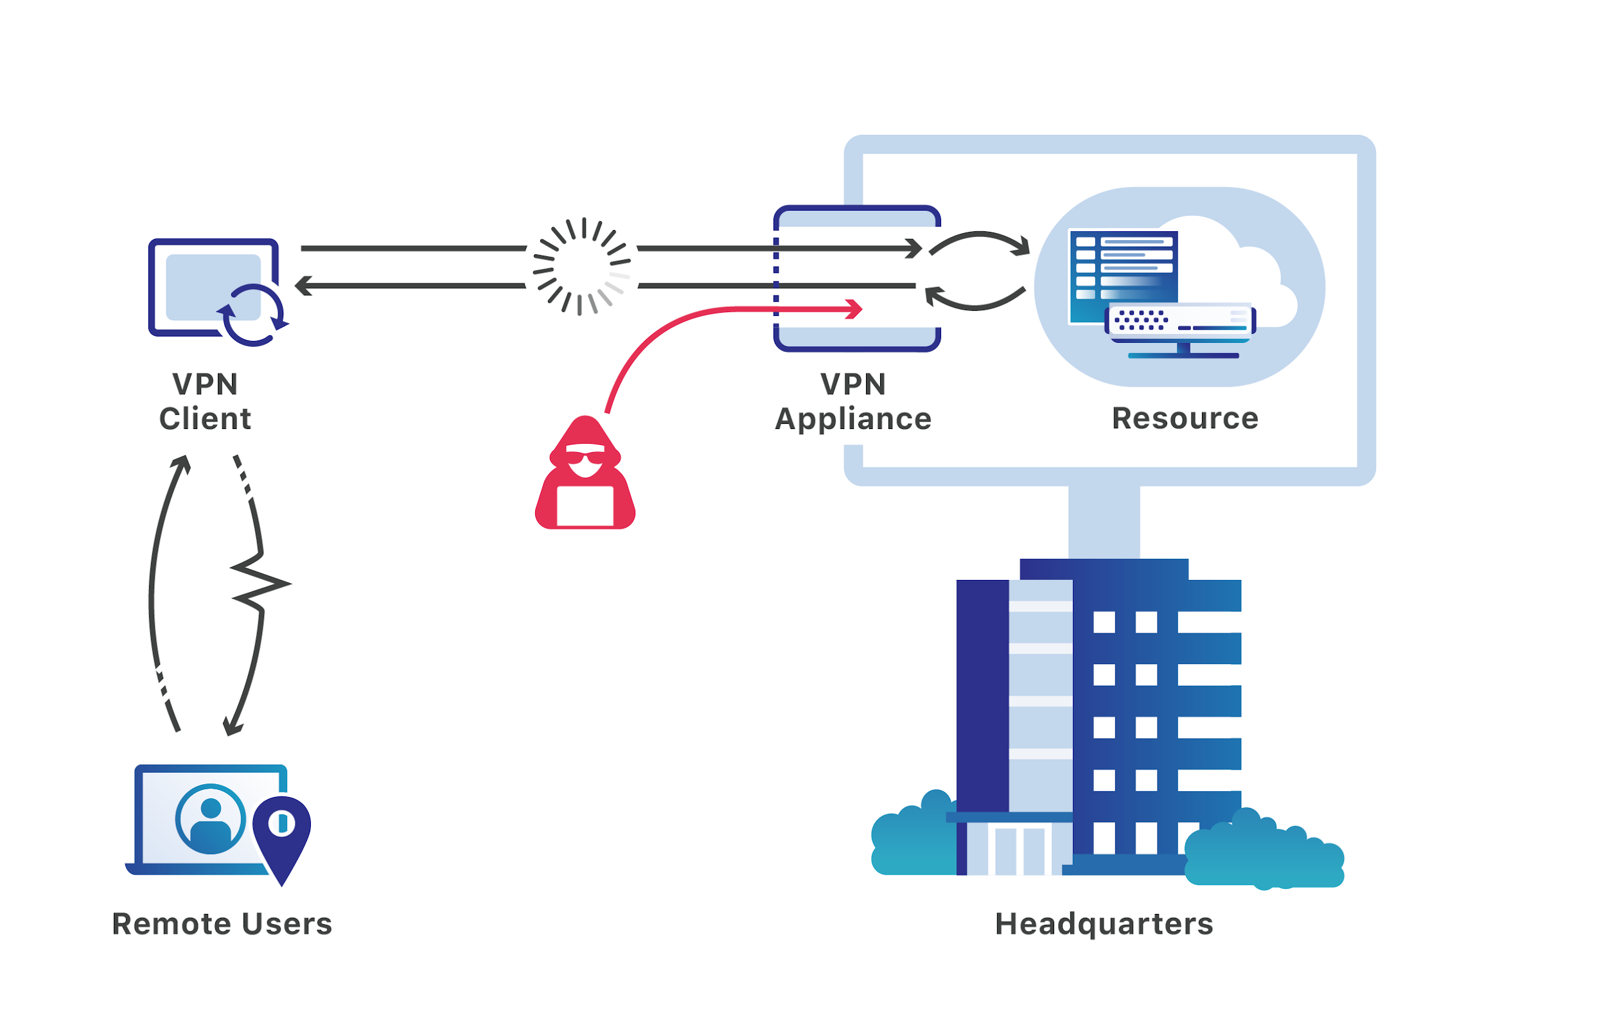
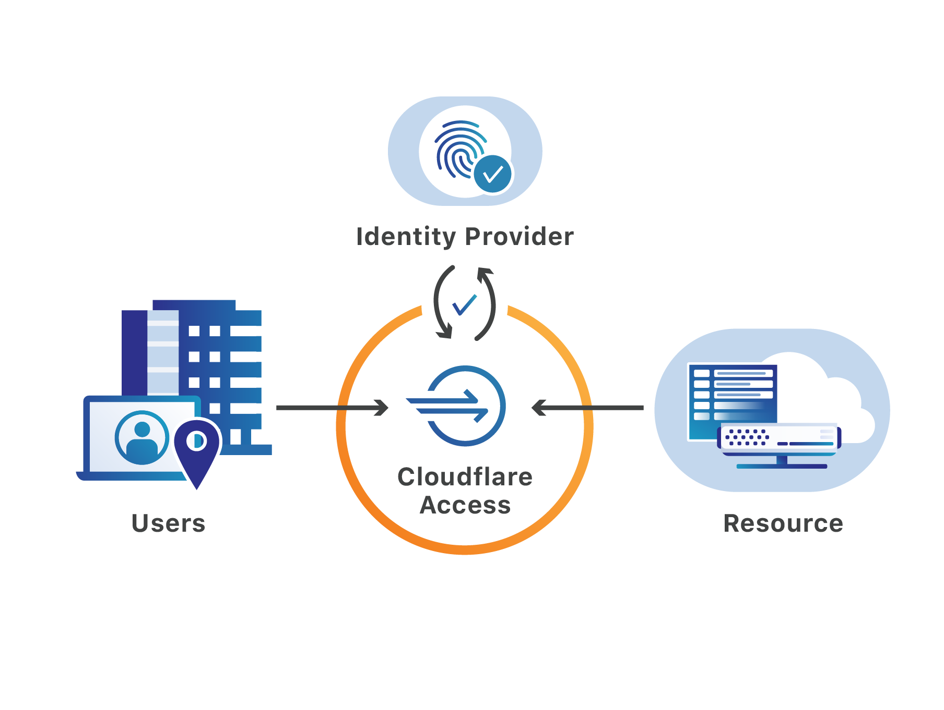
Legacy Problem
Cloudflare Solution
Notes:
Our Core security pillars which enables our customers to develop a strong security posture are Cloudflare for Infrastructure and Cloudflare for Teams

Slide 8
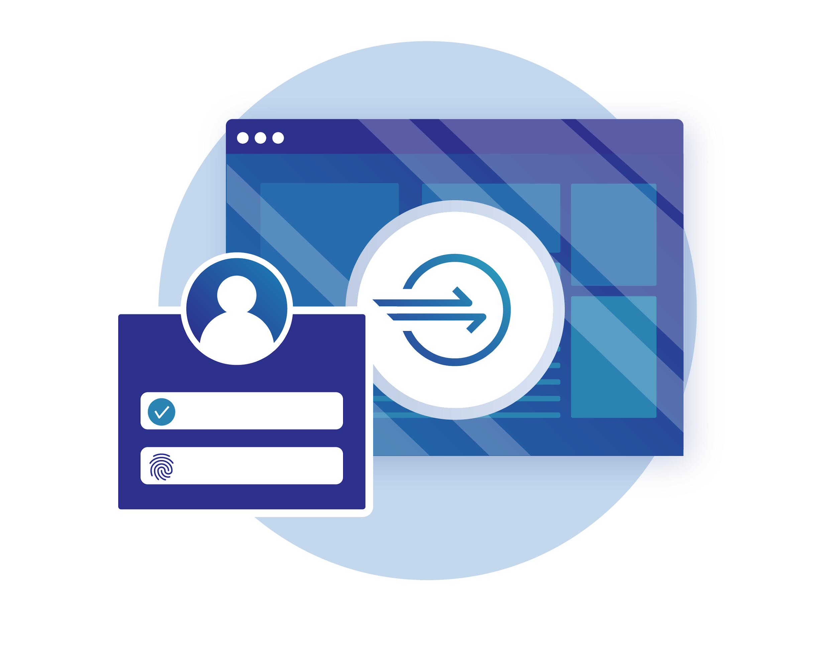
Cloudflare Access
Zero Trust Security Solution
Control User Access to Applications
Enforce access to specific applications on a per-user basis with easy-to-create and manage rules.
Deploy and Manage Access Control Quickly
Leverage existing identity providers and authenticate on the Cloudflare global network to provide Single Sign On.
Deliver Fast Applications to Devices Anywhere
Users get easy, secure, and fast access to internal applications wherever they are, from whatever device.
Monitor User Access and Change Logs
View and search real-time access logs in the dashboard or integrate with a third party SIEM.
Notes:
Talk Track
Securing internal applications using a VPN is complex, lacks granular control, and doesn’t meet the performance needs of mobile users. To solve these problems is why Cloudflare created Cloudflare Access.
Cloudflare Access protects internal resources without having to setup a VPN. With Cloudflare Access, only authenticated users with the required permissions are able to access specific resources behind the Cloudflare edge. Support for existing identity providers such as OneLogin, Google, GSuite, Github and more ensures the right users have easy and instant access regardless of physical location.

Slide 9
Cloudflare Access
Zero Trust Security Solution
See it in action with a quick demo
Notes:
Talk Track
Securing internal applications using a VPN is complex, lacks granular control, and doesn’t meet the performance needs of mobile users. To solve these problems is why Cloudflare created Cloudflare Access.
Cloudflare Access protects internal resources without having to setup a VPN. With Cloudflare Access, only authenticated users with the required permissions are able to access specific resources behind the Cloudflare edge. Support for existing identity providers such as OneLogin, Google, GSuite, Github and more ensures the right users have easy and instant access regardless of physical location.

Slide 10
Cloudflare Gateway

Slide 11
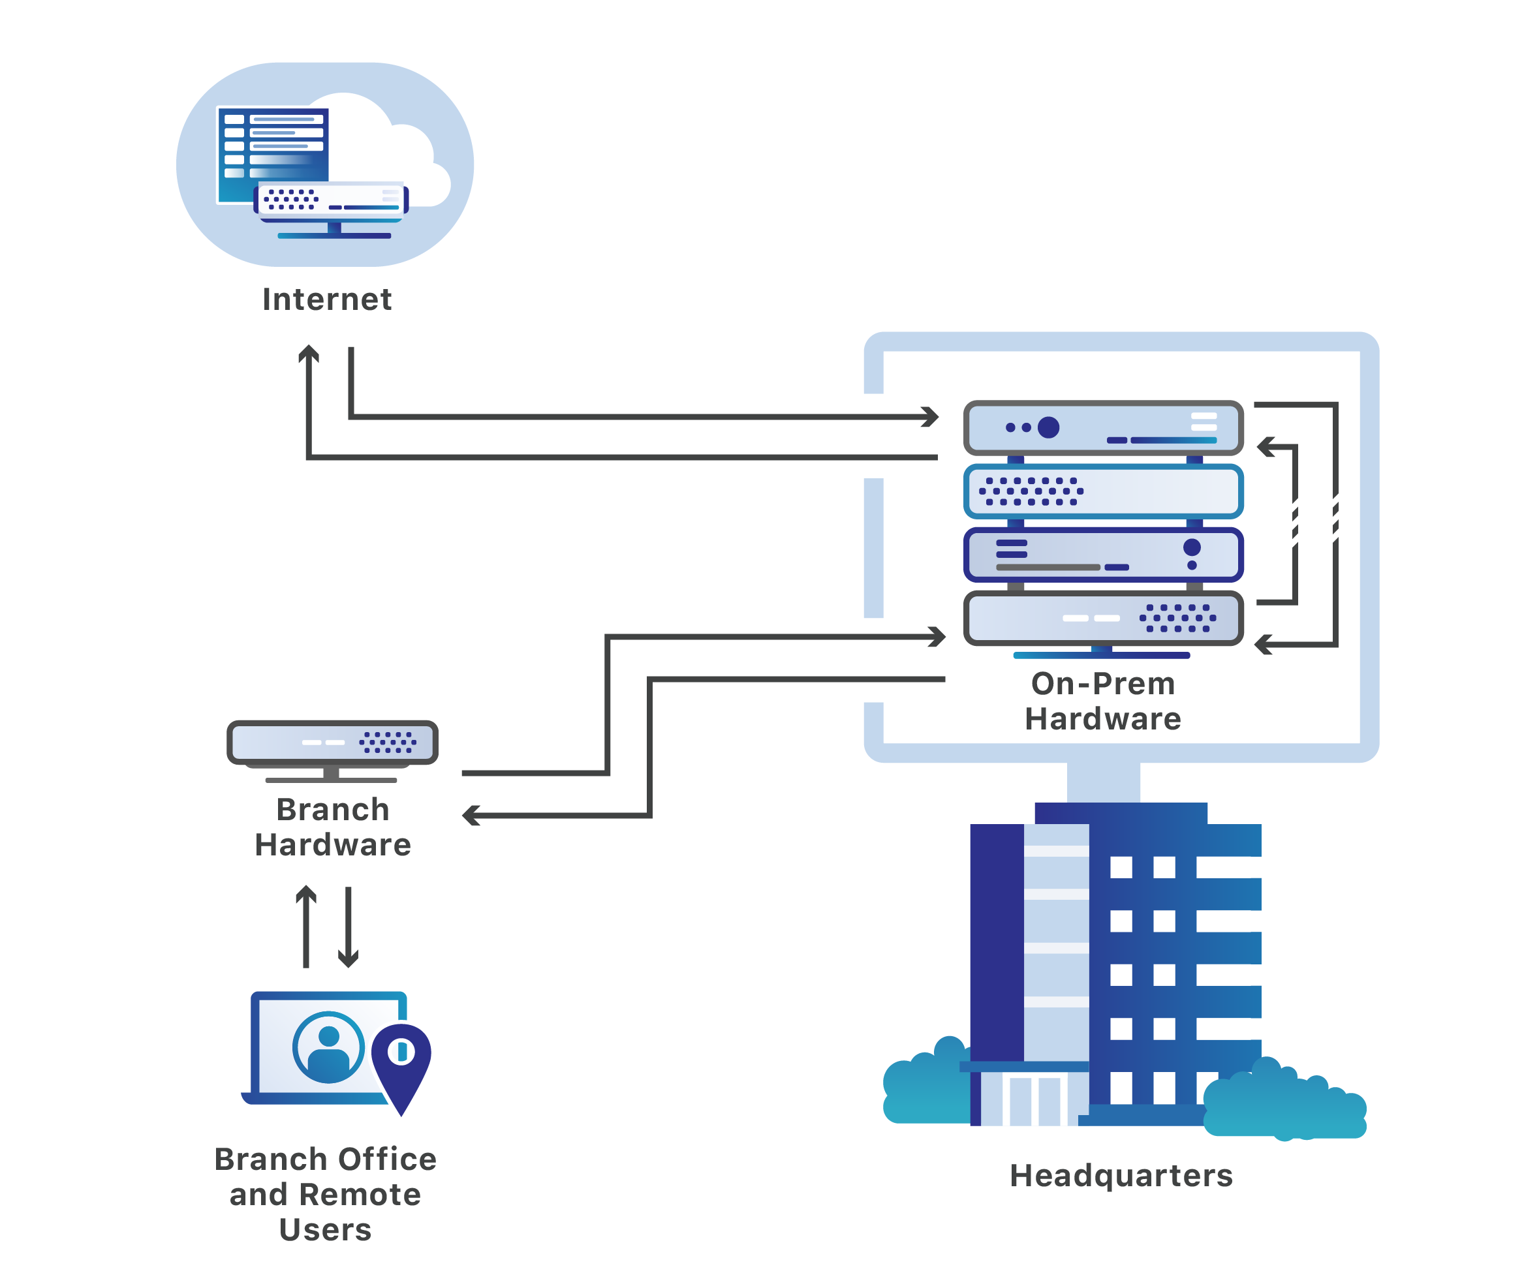
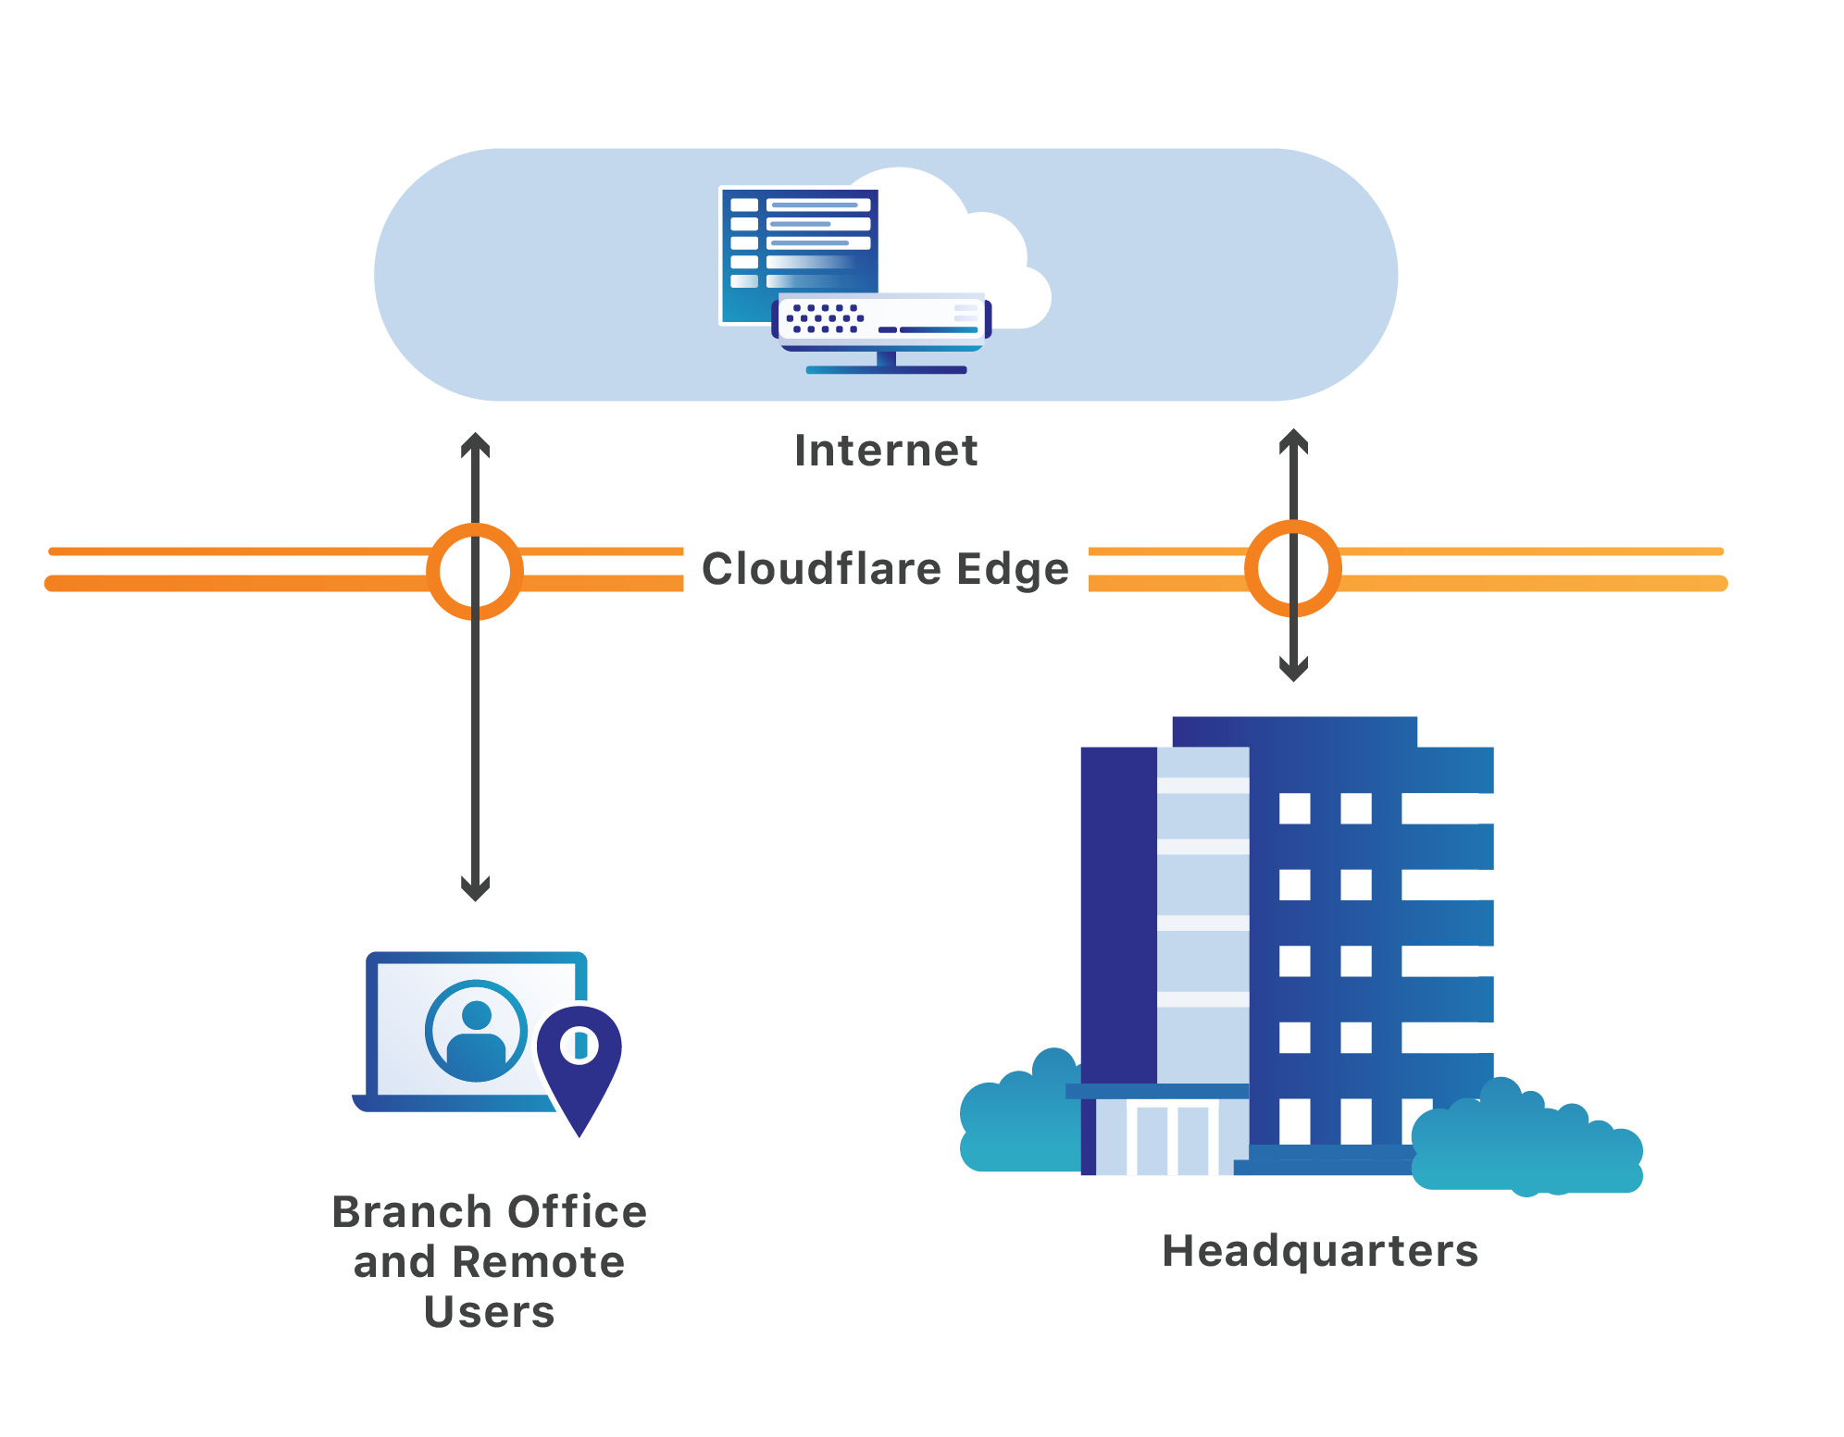
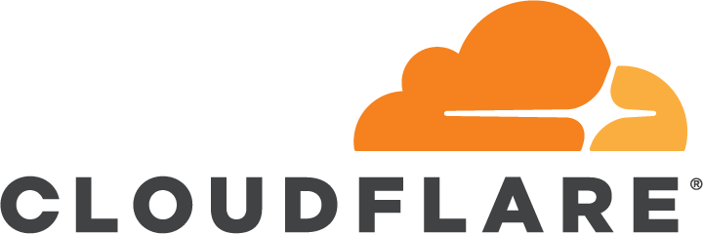
Cloudflare for Teams
Legacy Problem
Cloudflare Solution
Notes:
Our Core security pillars which enables our customers to develop a strong security posture are Cloudflare for Infrastructure and Cloudflare for Teams

Slide 12
Cloudflare Gateway
Secure Web Gateway Solution
Single pane of glass to manage access to the Internet
Users can configure policies to protect users, devices and networks from security threats, enforce file type control and manage access to sanctioned & unsanctioned SaaS applications.
Improve performance and reduce cost
Cloudflare Gateway enables businesses to send Internet bound traffic to Cloudflare’s nearest data center. All applications on the Internet get routed by Cloudflare’s Argo smart routing technology to enhance performance.
Granular visibility
Have visibility across all corporate devices both on and off the network to detect anomalies, compromised devices and prevent leak of sensitive data.
© 2018 Cloudflare Inc. All rights reserved.
Notes:
What are the problems are we solving?
Security threats: Corporate networks and devices are not secure from security threats on the Internet
Lack of visibility: No visibility into how your internet is being used? Where are corporate devices going?
Expensive: MPLS links to send traffic to a central data center is expensive
Performance: Backhauling traffic to one places slows things down
DLP: Intellectual property may get leaked
Before
Internet Gateway
Deploy endpoint security solutions on every device
Backhaul all Internet-bound traffic over MPLS
Filter traffic through hardware gateways
Data across both
Backhaul all traffic from branch offices to headquarters, where legacy hardware appliances inspect traffic, often via MPLS
Inspect all traffic in centralized, on-premise, DLP equipment
Configure manual access controls for each environment
After
No need. Configure corporate network to catch security threats using DNS filtering
Internet bound traffic routes to closest Cloudflare data center where traffic is routed using our Argo smart routing technology , no need for expensive MPLS links
Filter traffic through hardware gateways - No hardware, all traffic goes to closest Cloudflare data center, apply security policies without worrying about scale and acquiring expensive hardware
Talk Track
Securing internal applications using a VPN is complex, lacks granular control, and doesn’t meet the performance needs of mobile users. To solve these problems is why Cloudflare created Cloudflare Access.
Cloudflare Access protects internal resources without having to setup a VPN. With Cloudflare Access, only authenticated users with the required permissions are able to access specific resources behind the Cloudflare edge. Support for existing identity providers such as OneLogin, Google, GSuite, Github and more ensures the right users have easy and instant access regardless of physical location.

Slide 13
Cloudflare Gateway
Secure Web Gateway Solution
See it in action with a quick demo
© 2018 Cloudflare Inc. All rights reserved.
Notes:
What are the problems are we solving?
Security threats: Corporate networks and devices are not secure from security threats on the Internet
Lack of visibility: No visibility into how your internet is being used? Where are corporate devices going?
Expensive: MPLS links to send traffic to a central data center is expensive
Performance: Backhauling traffic to one places slows things down
DLP: Intellectual property may get leaked
Before
Internet Gateway
Deploy endpoint security solutions on every device
Backhaul all Internet-bound traffic over MPLS
Filter traffic through hardware gateways
Data across both
Backhaul all traffic from branch offices to headquarters, where legacy hardware appliances inspect traffic, often via MPLS
Inspect all traffic in centralized, on-premise, DLP equipment
Configure manual access controls for each environment
After
No need. Configure corporate network to catch security threats using DNS filtering
Internet bound traffic routes to closest Cloudflare data center where traffic is routed using our Argo smart routing technology , no need for expensive MPLS links
Filter traffic through hardware gateways - No hardware, all traffic goes to closest Cloudflare data center, apply security policies without worrying about scale and acquiring expensive hardware
Talk Track
Securing internal applications using a VPN is complex, lacks granular control, and doesn’t meet the performance needs of mobile users. To solve these problems is why Cloudflare created Cloudflare Access.
Cloudflare Access protects internal resources without having to setup a VPN. With Cloudflare Access, only authenticated users with the required permissions are able to access specific resources behind the Cloudflare edge. Support for existing identity providers such as OneLogin, Google, GSuite, Github and more ensures the right users have easy and instant access regardless of physical location.

Slide 14
Gateway Features
FEATURES
AVAILABLE TODAY
Q2 2020
Q3 AND BEYOND
DNS-based security and content filtering
Always-on browser isolation
Advanced threat protection
Cloudflare Warp: client for remote users
SD-WAN integration (powered by Magic Transit)
Cloud sandbox and file type control
Bandwidth control
CASB integration
Deep packet inspection
Data loss prevention
Logging integration with third-party SIEM

Slide 15
Summary
Faster
We are building on our expertise improving performance and delivery from data centers in 200 cities around the world. Internal sites perform better and Internet connections move faster.
Cost-effective
Cloudflare for Teams leverages Cloudflare’s history of reducing bandwidth costs to deliver a cost-effective solution to businesses of any size.
Smarter
Applies the threat intelligence we collect from securing 20M internet properties and blocking 72B cyber threats per day across 11M HTTP requests per day on average.

